Slide 1
LOGISTICS & SUPPLY CHAIN
USING BLOCKCHAIN

Slide 2
Logistics and Supply Chain
Logistics is a coordinating process of moving any resources like people, materials, goods from storage location to the desired location.
Supply chain is a process which involves all the people and process involved in the creation, manufacturing and sale of any particular goods or products.
Smart Contracts are set of rules and conditions that are defined for an application and only if these conditions are met, the transaction happens.
Ganache is a platform which is used to setup personal Ethereum blockchain and also provide private key for security purpose.

Slide 3
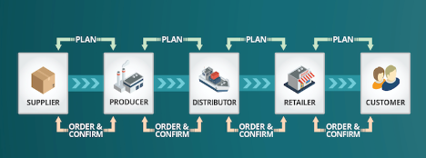
Problems in traditional Supply chain management
Lack of End-to-End visibility and Transparency
Risks such as sourcing, transport, facility and distribution.
Disruptions due to Geopolitical Tensions
Cyberattacks
Critical Product Stockouts

Slide 4
Challenges in Supply Chain
Lack of Trust
High Cost
Relatively Slow
Regulations & Quality
Poor Customer Service

Slide 5
BLOCKCHAIN
Blockchain is a distributed ledger technology that allows for secure, transparent, and tamper-proof record-keeping.
It uses cryptographic techniques to protect data and guarantee the immutability of recorded information, making it extremely difficult to tamper with.
Blockchain transactions and data are transparent and visible to all participants in the network, promoting trust and reducing the need for intermediaries.
Blockchain provides the infrastructure for smart contracts to run securely and transparently.

Slide 6
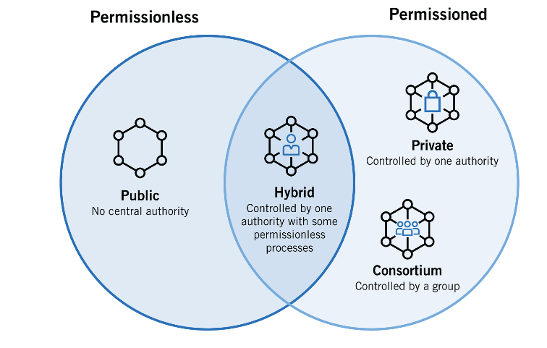
Types of Blockchain
Public Blockchain
Private Blockchain
Hybrid blockchain
Consortium blockchain

Slide 7
How can Blockchain help?
Reduced Risk
Peer-To-Peer Transaction Settlement
Tracking Products & Consumer Feedback

Slide 8
How can Blockchain help?
Building Trust
Reducing Complexities
Enhanced Visibility

Slide 9
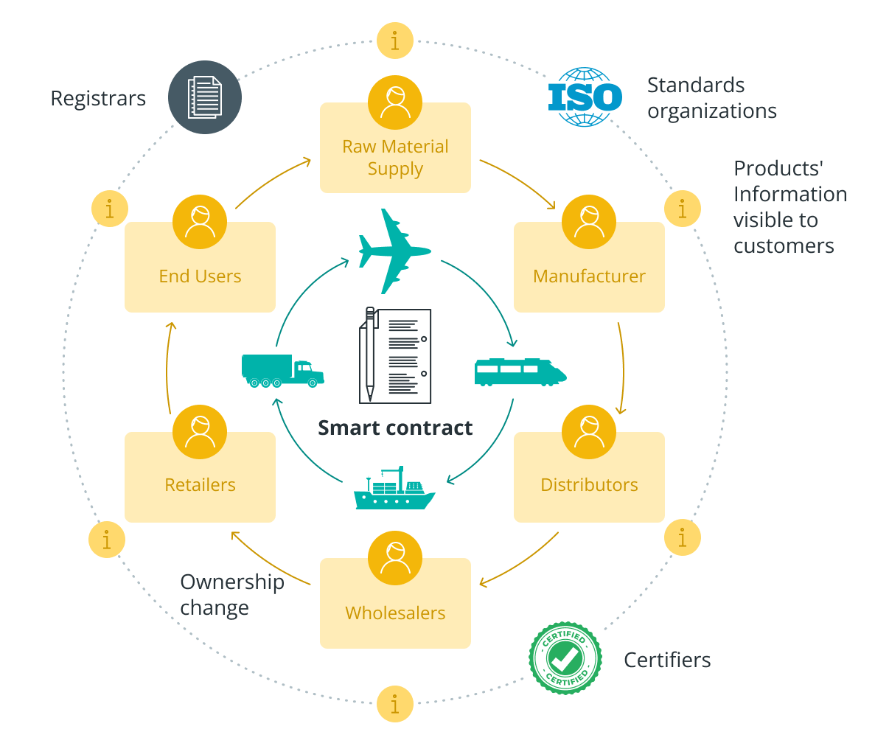
Blockchain Implementation

Slide 10
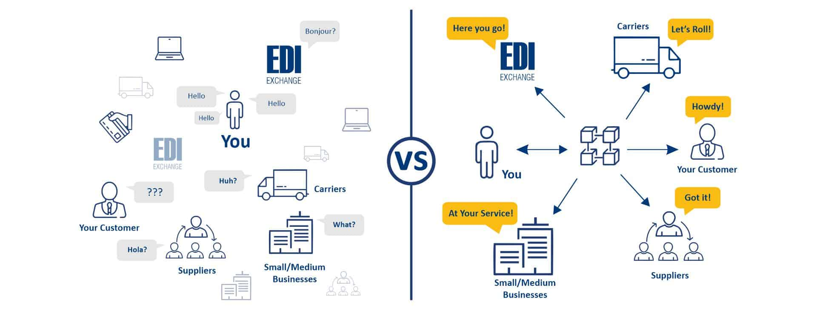
Regular Vs Blockchain Model

Slide 11
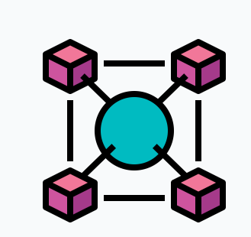
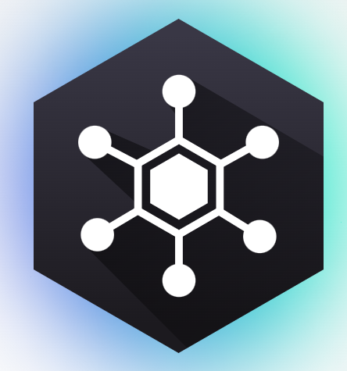
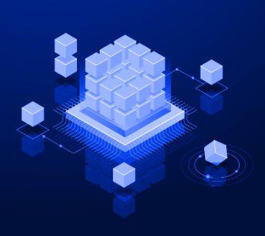

Challenges during implementation of blockchain
Integration Complexity
Interoperability
Scalability
Data Privacy and Security

Slide 12
Case Study Using Blockchain and IoT for Shipment Tracking
The project's goal was to solve the problem of the restricted availability of shipping data for different parties to analyze, which represents a missed chance to enhance supply chain management.
Deloitte teams developed a blockchain-based solution that leveraged IoT sensors to track parcels or shipments in real-time and collect valuable data insights.
Improved supply chain efficiency and transparency resulted from the solution's ability to let several parties access and evaluate data in a decentralized repository.

Slide 13
Case Study Simplifying patient consent and biological sample management in clinical trials: a proof of concept based on blockchain
This case study focuses on BioTrack & Trace which is a blockchain-based solution designed to simplify patient consent and biological samples management in clinical trials.
The Proof of Consent (PoC) integrates biosample collection, storage, sharing, consent, and analysis procedures into a blockchain.
By using blockchain technologies, it ultimately improves tracking mechanisms, traceability, and consent management across the clinical trial’s value chain

Slide 14
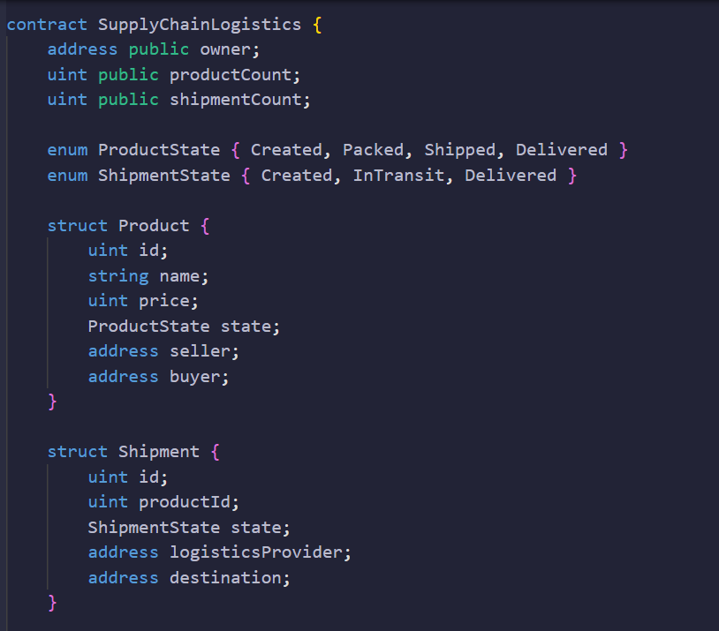
Implementation

Slide 15
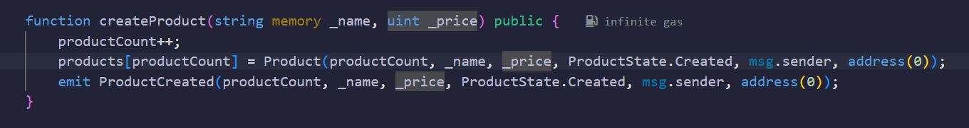
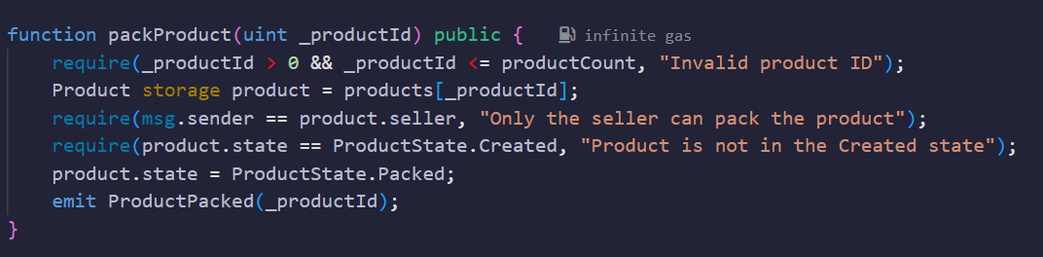
Implementation

Slide 16
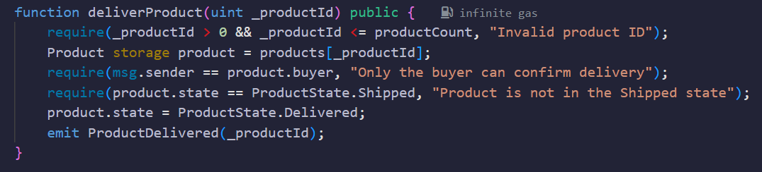
IMPLEMENTATION

Slide 17
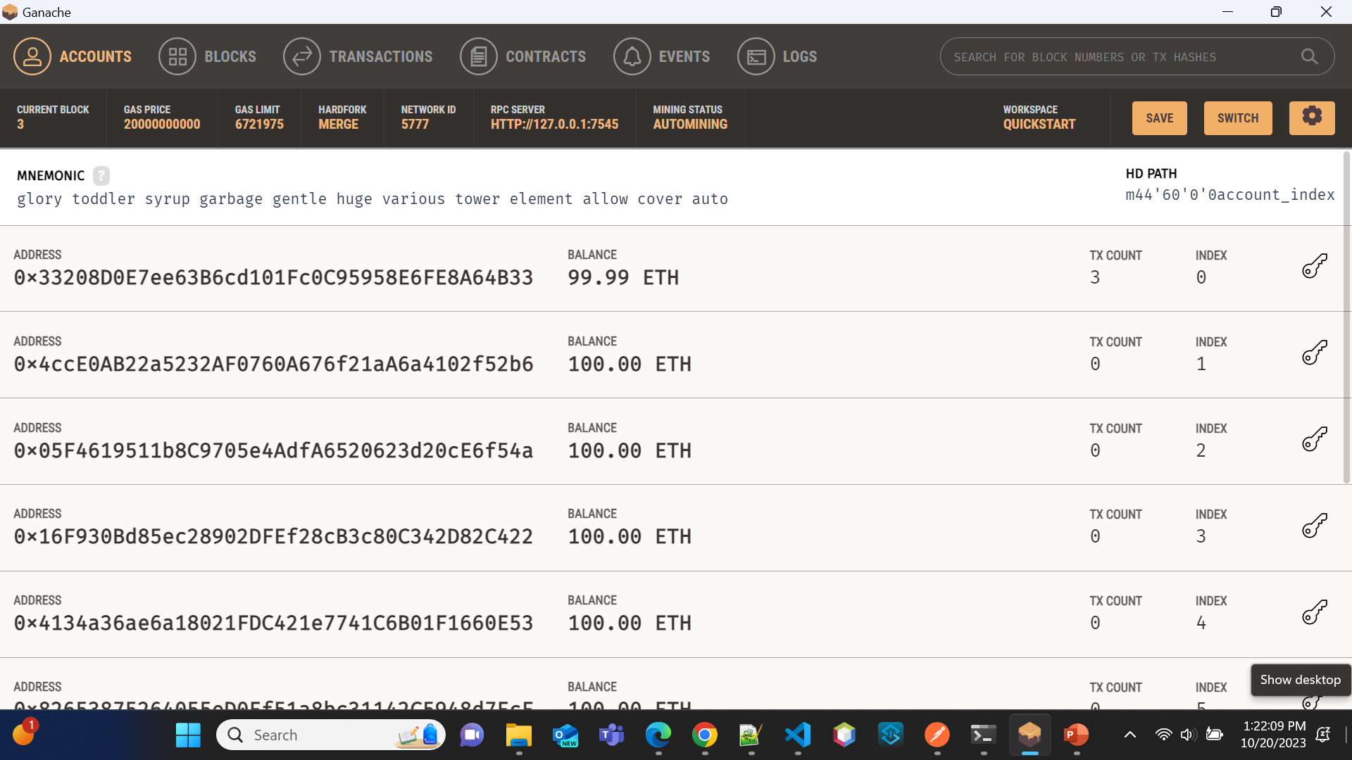
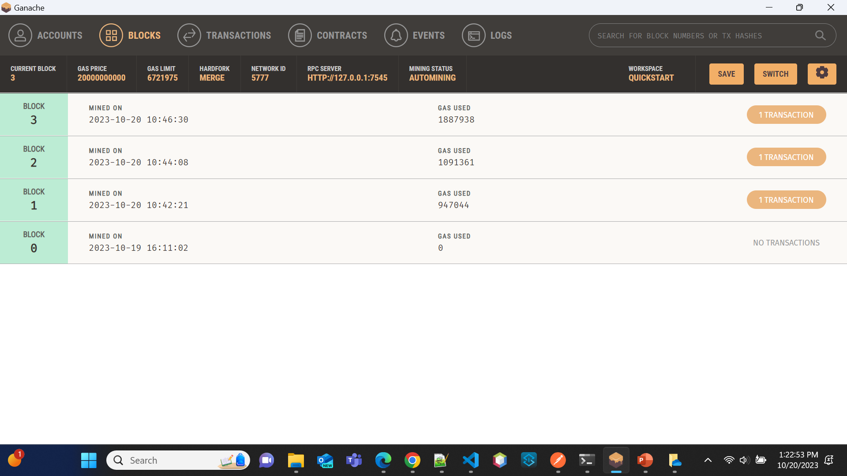
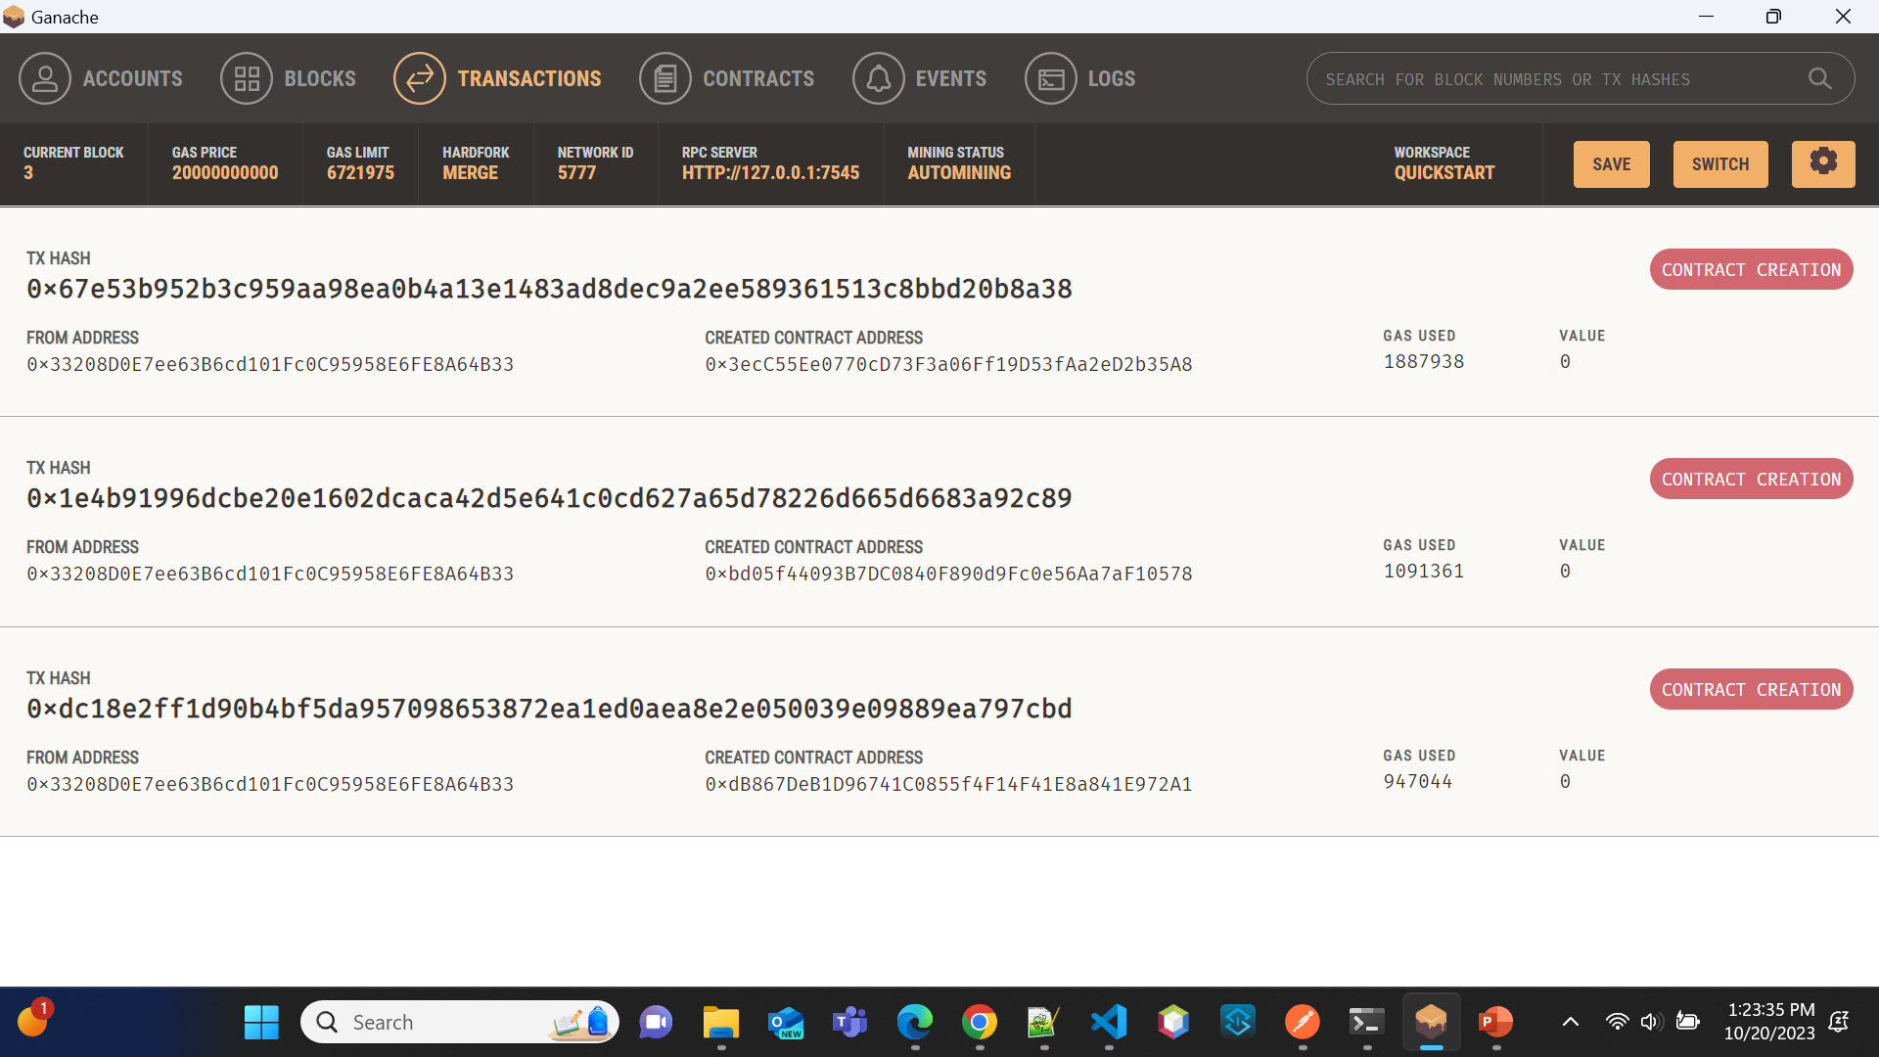

Slide 18

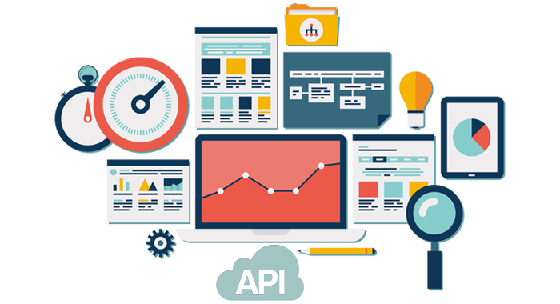
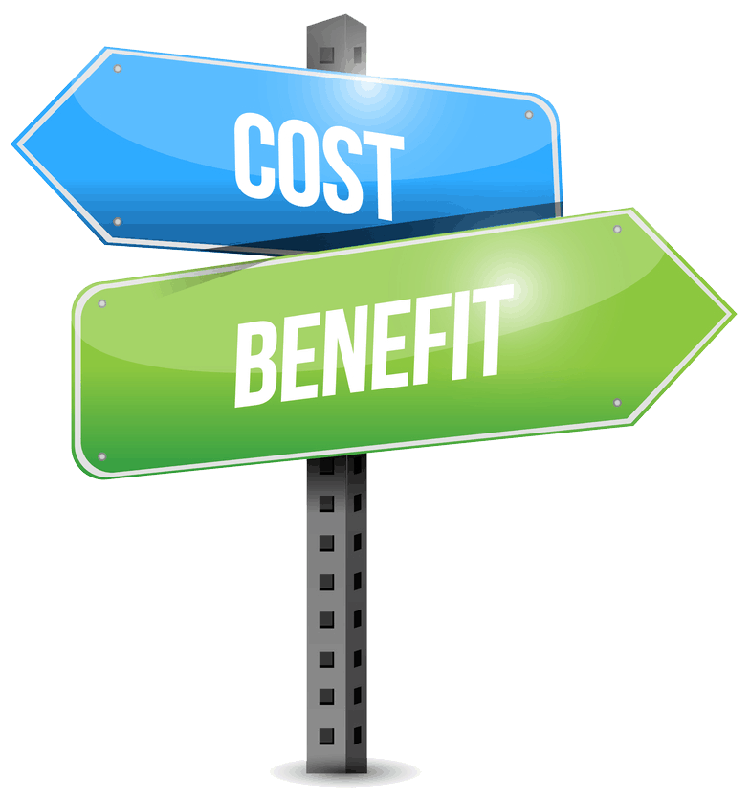
Future Trend
Cost-Benefit Analysis
Integration with Emerging Technologies
Scalability and Performance Optimization

Slide 19
Conclusion
There exists substantial room for enhancement in supply chains, spanning aspects like end-to-end traceability, product delivery speed, coordination, and financing.
Blockchain technology has emerged as a potent solution to tackle these shortcomings, as demonstrated by the companies we've analyzed.
The time has come for supply chain managers to actively assess blockchain's potential for their operations.
While this journey demands resource commitment, the anticipated returns make it a worthwhile investment.

Slide 20
THANK YOU

